Slide 1
Medical Data History
PTID_CDA-JUL-23-022-PRSQ-01

Slide 2
Introduction
Project Overview
Fetching Data
Problem Queries
Project Goals
Conclusion
Results
Insights

Slide 3
Introduction
The purpose of this project was to demonstrate the ability to fetch data from a client using SQL queries and to solve some challenging problems with those queries. Today, we will walk you through the project overview, the data used, the problem queries, the results, and the insights gained from this project.
Project Overview
For this project, we utilized MySQL Workbench to create a database for a hypothetical hospital. The goal was to create a system that could efficiently store and manage patient information, such as personal details, medical history, and allergies. We also aimed to create a user-friendly interface for medical professionals to easily access and update patient records.
To achieve these goals, we used a variety of data types, including integers, strings, and dates, to accurately represent patient information. we also implemented various SQL commands, such as SELECT, INSERT, UPDATE, and DELETE, to manipulate and retrieve data from the database. Additionally, we created several views to simplify complex queries and provide a more intuitive interface for users.

Slide 4
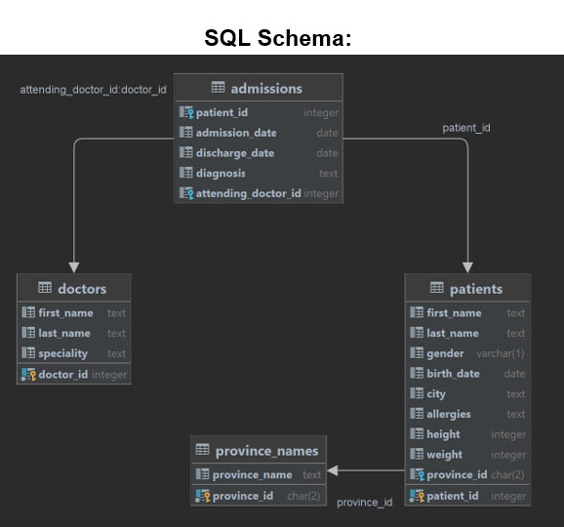

Slide 5
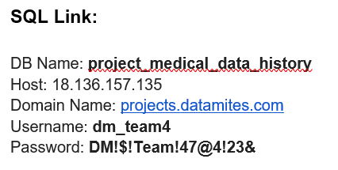
Fetching Data
To fetch data for this project, we used MySQL Workbench to connect to the client's database with the provided credentials. We then ran a series of queries to extract the necessary data for our analysis. The process of fetching the data was straightforward.

Slide 6
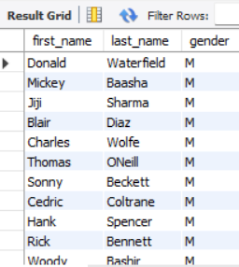
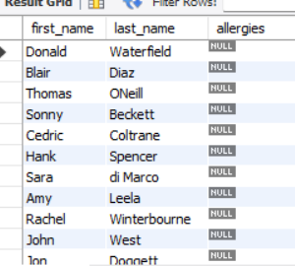

1.Patient Demographics: Extracted and displayed the first name, last name, and gender of patients with the gender 'M'.
2. Allergies Analysis- Identified patients without allergies by displaying their first name and last name.

Slide 7
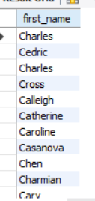

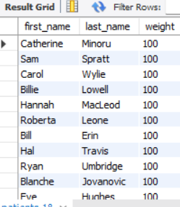
3. Name Filtering:- Listed patients with first names starting with the letter 'C'.
4. Weight Range Exploration:-Analysed patients within a weight range of 100 to 120 (inclusive) by displaying their first name and last name.

Slide 8
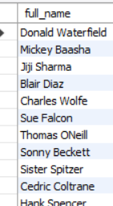
5. Data Enhancement:- Enhanced data quality by updating the patients table, replacing null values in the allergies column with 'NKA'.
6. Name Concatenation:- Created a column displaying the full name of patients by concatenating their first name and last name.

Slide 9
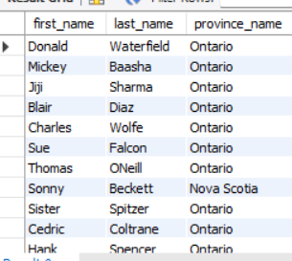




7. Location Insights: - Presented patients' first name, last name, and their province for a comprehensive understanding of their locations.
8. Birth Year Analysis:- Determined the number of patients born in the year 2010.
9. Height Exploration:- Identified the patient with the greatest height and displayed their first name, last name, and height.

Slide 10
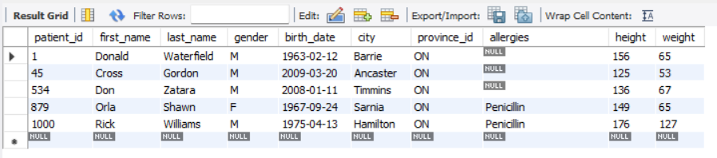


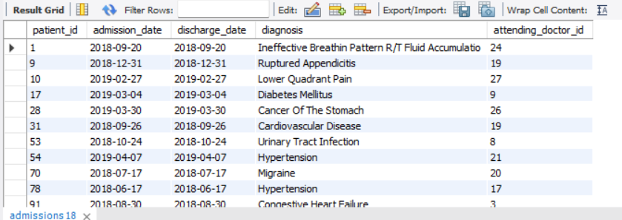
10. Selective Patient Data:- Displayed all columns for patients with specific IDs (1, 45, 534, 879, 1000).
11. Admission Metrics:- Calculated and presented the total number of admissions.
12. Same Day Admissions:- Explored cases where patients were admitted and discharged on the same day, displaying all columns from the admissions table.

Slide 11


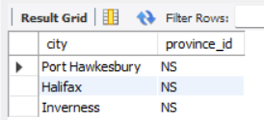
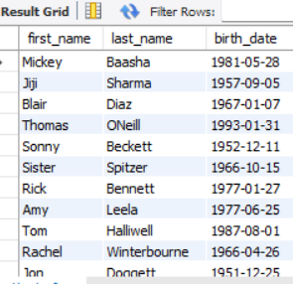
13. Patient-Specific Admissions: - Counted the total number of admissions for a specific patient (patient_id 579).
14. City Analysis:- Identified unique cities in province_id 'NS' based on patient residences.
15. Height and Weight Criteria:- Displayed first name, last name, and birth date of patients meeting height (>160) and weight (>70) criteria.

Slide 12
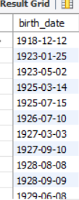

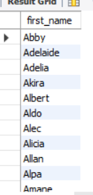

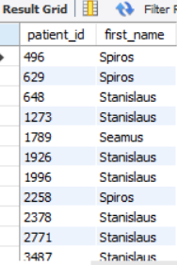
16. Birth Year Trends:- Explored unique birth years among patients and ordered them in ascending order.
17. Distinct First Names:- Listed unique first names that occur only once in the list, utilizing the HAVING clause for aggregate functions.
18. Name Patterns:-Displayed patient_id and first_name for patients with first names starting and ending with 's' and being at least 6 characters long.

Slide 13
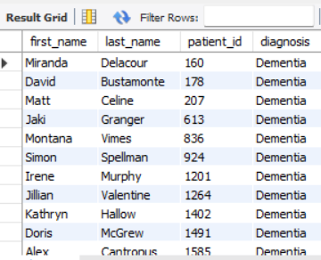
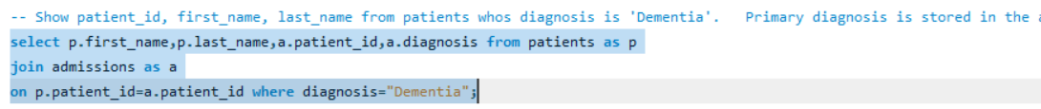
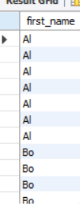

19. Diagnosis Details:- Showcased patient_id, first_name, and last_name for patients diagnosed with 'Dementia'.
20. Name Sorting:- Displayed each patient's first_name, ordered by name length and then alphabetically.
21. Gender Breakdown: - Presented the total count of male and female patients in a single row.

Slide 14
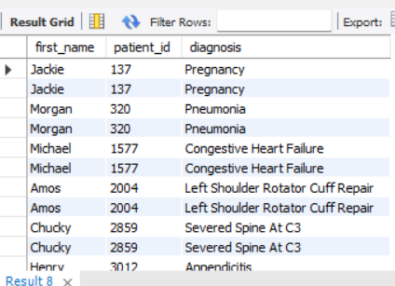
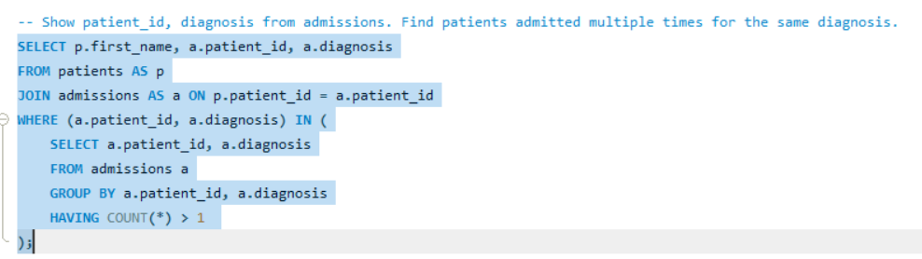
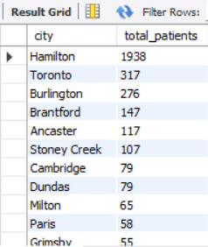
22. Repeated Diagnoses:- Displayed patient_id and diagnosis for patients admitted multiple times with the same diagnosis.
23. City and Patient Count: - Listed cities along with the total number of patients in each city, ordered by patient count and then city name.

Slide 15
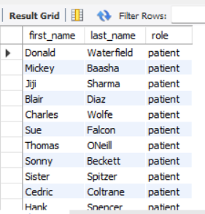
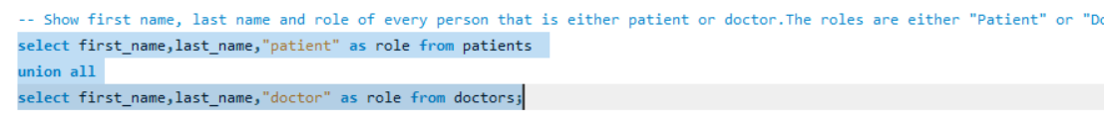
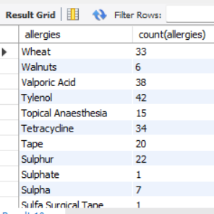
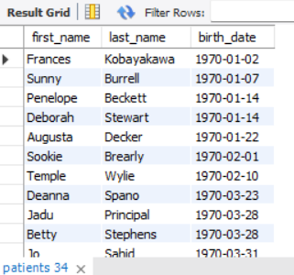
24. Role and Identity:- Displayed first name, last name, and role (either "Patient" or "Doctor") for individuals with these roles.
25. Allergies Insights:- Explored allergies ordered by popularity, excluding NULL values.
26. Birth Decade Analysis:- Showcased first name, last name, and birth date for patients born in the 1970s decade, sorted chronologically.

Slide 16
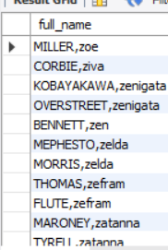
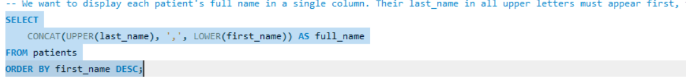
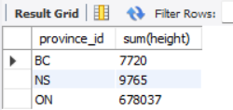

27. Name Formatting:- Consolidated last_name in uppercase, followed by first_name in lowercase, separated by a comma, and ordered in descending order by first_name.
28. Province Heights:- Presented province_id and the sum of height for provinces with a total height sum greater than or equal to 7,000.
29. Weight Range:- Calculated and displayed the difference between the largest and smallest weights for patients with the last name 'Maroni'.

Slide 17
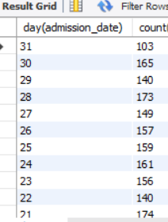
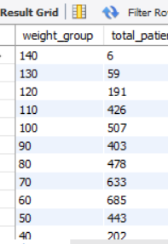
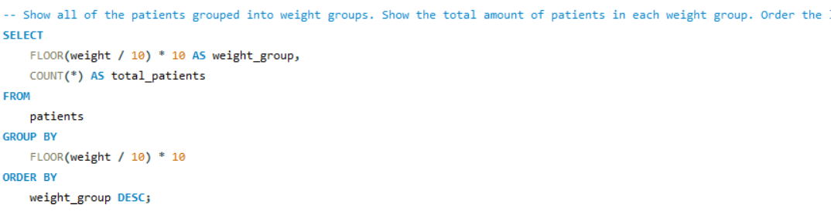
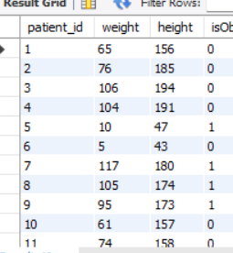
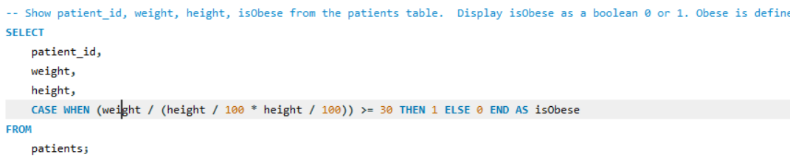
31. Admission Dates Distribution: - Analysed the distribution of admission_dates by day (1-31), showcasing the number of admissions per day.
32. Weight Groups:- Grouped patients based on weight ranges, displaying the total patient count in each group, ordered by weight group in descending order.
33.Obesity Indicator:- Displayed patient_id, weight, height, and an isObese indicator (0 or 1) based on predefined obesity criteria.

Slide 18
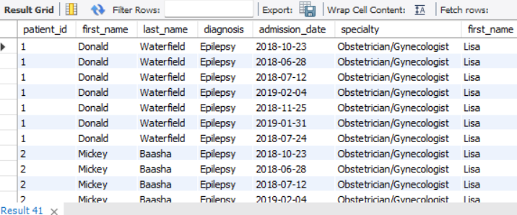
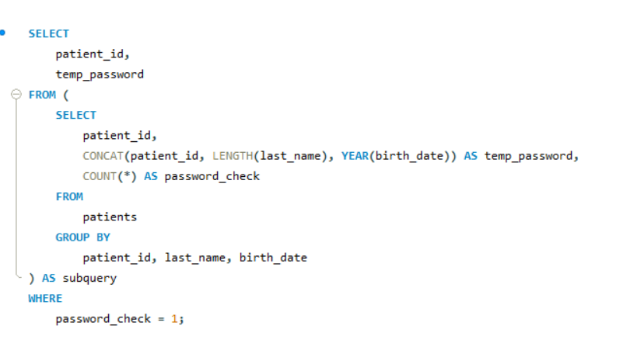
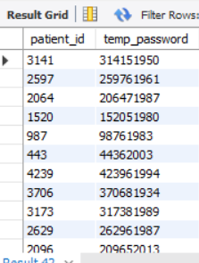
34. Diagnosis and Specialty:- Presented patient_id, first_name, last_name, and attending doctor's specialty for patients diagnosed with'Epilepsy' and attended by Doctor Lisa.
35. Temporary Password Generation:- Generated temporary passwords for patients who can access medical documents, based on a specific pattern derived from patient details.

Slide 19
Conclusion
This comprehensive SQL project demonstrates my proficiency in data manipulation, extraction, and analysis. By utilizing SQL queries, I successfully derived valuable insights from complex hospital data, showcasing the ability to work with large datasets and deliver actionable information.
Results
After completing the SQL project using MySQL Workbench, we were able to successfully fetch data from the client using the given credentials. We faced some challenges during this process, but were able to overcome them and move on to performing problem queries.
Through these problem queries, we were able to gain valuable insights into the patient data. For example, we found that there were more male patients than female patients in the dataset. We also discovered that many patients did not have any allergies listed in their records. Overall, these queries allowed us to better understand the patient data and draw conclusions that could be applied in real-world scenarios.
Insights
Through this project, we gained insights into the power of SQL and its ability to handle large amounts of data efficiently. We also learned how to use MySQL Workbench effectively to manage databases and perform complex queries. These skills could be applied in a real-world scenario where data management is crucial for decision-making.
Furthermore, by analyzing the patient data, we were able to identify patterns and trends that could inform healthcare policies and practices. For example, we found that there were more male patients than female patients in our dataset, which could suggest a need for targeted healthcare interventions for women. These insights demonstrate the potential impact of data analysis in improving healthcare outcomes.

Slide 20
Thank you

